Slide 1
Sleep Health and Lifestyle Analysis Using Machine Learning
Rameswaram Kumar Viswanath MSDS - 610

Slide 2
Dataset Details
Dataset Name: Sleep Health and Lifestyle Dataset
Source: https://www.kaggle.com/datasets/uom190346a/sleep-health-and-lifestyle-dataset
Brief Description: This dataset contains information about sleep patterns, lifestyle habits, and health metrics of individuals. It includes attributes such as age, gender, occupation, sleep duration, quality of sleep, physical activity levels, stress levels, BMI category, blood pressure, heart rate, and daily steps.

Slide 3
Dataset Description
Field Name | Data Type | Description | Relevance to Problem
Person ID | Discrete | Unique identifier for each individual | Not directly relevant for prediction
Gender | Nominal | Male or Female | May influence sleep patterns and quality due to biological or societal factors.
Age | Continuous | Age of the individual | Can significantly impact sleep needs and health.
Occupation | Nominal | Job or profession | May influence lifestyle factors affecting sleep, such as work stress and sleep schedules.
Sleep Duration | Continuous | Average sleep duration in hours | Directly relevant for predicting sleep quality.
Quality of Sleep | Ordinal | Subjective measure of sleep quality | Target Variable for Prediction
Physical Activity Level | Ordinal | Level of physical activity | Impacts sleep quality and overall health.
Stress Level | Ordinal | Perceived stress level | Significantly influences sleep quality.

Slide 4
Dataset Description
Field Name | Data Type | Description | Relevance to Problem
BMI Category | Nominal | Body Mass Index category (e.g., Underweight, Normal, Overweight, Obese) | Related to overall health and can impact sleep quality and disorders.
Blood Pressure | Continuous | Blood pressure measurement | An indicator of overall health, potentially related to sleep quality and sleep disorders.
Heart Rate | Continuous | Average resting heart rate | An indicator of cardiovascular health, which can affect sleep.
Daily Steps | Discrete | Number of steps walked per day | Reflects physical activity level and overall health.
Sleep Disorder | Nominal | Presence of any diagnosed sleep disorders | Not directly relevant to the current problem

Slide 5
EDA
Stress and Heart Rate: The positive correlation between "Stress Level“and "Heart Rate" supports the well-established physiological link between stress and the cardiovascular system. Higher stress levels can lead to increased heart rate as part of the body's stress response.
Stress and Sleep Quality: The strong negative correlation between "Stress Level" and "Quality of Sleep" is significant. It highlights that high stress levels are likely to have a detrimental impact on sleep quality.
Sleep Duration and Stress: The negative correlation between "Sleep Duration" and "Stress Level" suggests that inadequate sleep may contribute to increased stress levels. This creates a potential feedback loop where poor sleep can lead to increased stress, which can further disrupt sleep.
Heart Rate and Sleep Quality: The negative correlation between "Heart Rate" and "Quality of Sleep" indicates that individuals with lower resting heart rates might tend to report better sleep quality. This could be related to better overall cardiovascular health.

Slide 6
Problem Statement
Problem: Predict the subjective "Quality of Sleep" for individuals based on their lifestyle factors, health metrics, and sleep duration.

Slide 7
Machine Learning System steps
1. Data Collection: This is the initial step where you gather the raw data for your project
2. Data Preprocessing: This step involves preparing the raw data for the machine learning model addressing issues like missing values and converting data into a suitable format.
3. Feature Selection: This step involves identifying the most relevant features from the dataset that will contribute most effectively to the model's predictions.
4. Model Training :This is where the machine learning model is built. A machine learning algorithm is selected and trained on the prepared data.
5. Model Evaluation: This step assesses the performance of the trained model. The trained model's performance is assessed using a separate test dataset.
6. Deployment :This step involves making the trained model available for use in a real-world.

Slide 8
Machine Learning System architecture
Data Collection
Data Preprocessing
Feature Selection
Model Training
Deployment
Model Evaluation

Slide 9
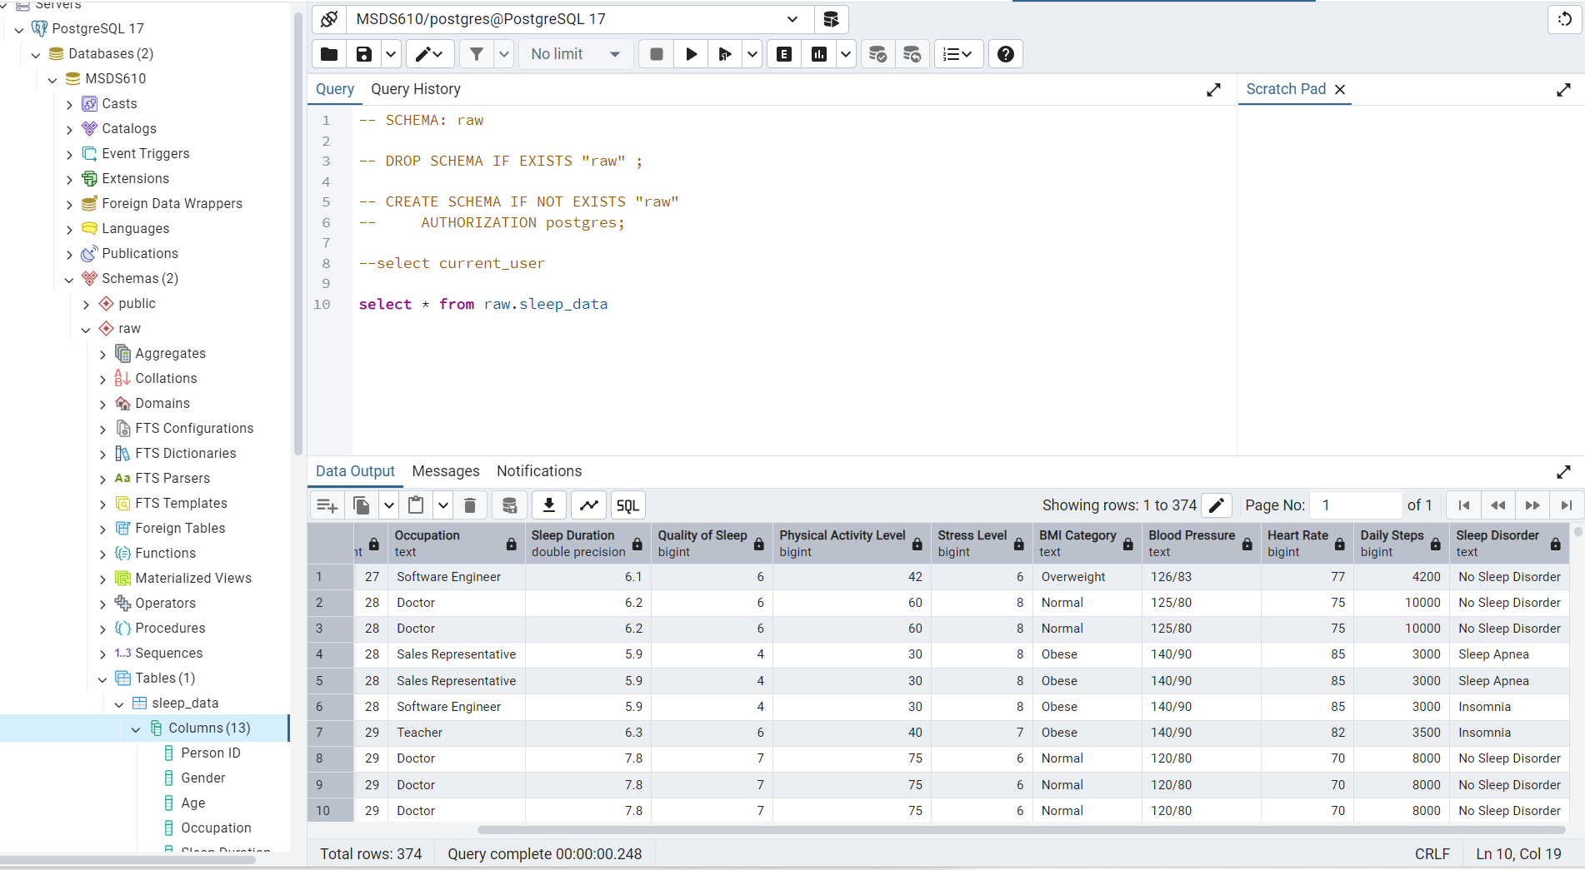
Loaded Data in pgAdmin

